Slide 1

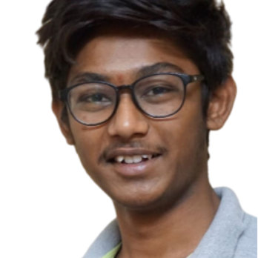
Lankalapalli Arun Sai Rohith
Senior Software Engineer | DevOps Engineer |
Bachelor of Information Technology from PVP Siddhartha Institute of Technology – 2019
Certification in GSDC - 2023
lankalapalli-arun-sai.rohith@capgemini.com
8121322281
Bangalore
Telugu, English, Hindi
An ambitious and dedicated individual eager to launch a career in DevOps with a solid foundation in DevOps and its Tools. Equipped with relevant knowledge on Git, Docker, Kubernetes, Jenkins and AWS DevOps. I am excited to apply my knowledge and learn new technologies in the dynamic field of DevOps.
With a proactive approach to learning and a passion for problem-solving, I am committed to mastering DevOps practices and contributing effectively to project initiatives. I possess strong analytical skills, attention to detail, and the ability to thrive in fast-paced environments.
As a DevOps fresher, I am enthusiastic about the opportunity to collaborate with team members, contribute to innovative projects, and drive continuous improvement in operational efficiency. I am eager to learn from experienced professionals and make a meaningful impact in the DevOps Domain
2023 - Present: Capgemini
Languages | Java, Python
Key Areas | Git,Docker,Kubernetes,Jenkins,AWS
Database | SQL
Operating Systems | Windows, Linux

Slide 2
Assignments
Project Name - 1 | Ecommerce Website Deployment using GCP Kubernetes
Client | CG Internal Training
Role | Senior Analyst
Roles performed | Key responsibilities: Kubernetes Deployment Management: Take charge of deploying pods using replica sets specified in deployment configuration files. Service Provisioning with NodePort: Establish and manage Kubernetes services using NodePort to expose applications externally. Container Orchestration: Utilize Kubernetes orchestration capabilities to manage the lifecycle of pods and their replicas. Networking and Communication: Configure Kubernetes networking to facilitate communication between pods and external services. Define network policies to control traffic flow and enforce security measures within the cluster.
Technology used in project | Google Cloud Platform
 | Git
 | Kubernetes
Description | For the seamless deployment and management of containerized applications within Kubernetes clusters. primary focus will be on orchestrating the deployment of pods using replica sets defined in deployment configuration files

Slide 3
Assignments
Project Name - 2 | Jenkins CI-CD Pipeline
Client | CG Internal Training
Role | Senior Analyst
Roles performed | Key responsibilities: •Code quality - Write high-quality code adhering to coding standards. •Use version control systems (e.g., Git) for source code management and commit code changes with meaningful comments. •Set up and configure CI servers (e.g., Jenkins, GitLab CI) and configure triggers to initiate builds on code changes. •Implement build pipelines with Maven for compiling, testing, and packaging.
Technology used in project | Jenkins
 | AWS
 | Nexus,Sonarqube,Git,Tomcat
Description | To streamline the software development lifecycle by implementing efficient Continuous Integration/Continuous Deployment (CI/CD) pipelines using Jenkins on the Amazon Web Services (AWS) cloud platform.

